Slide 1
Chapt3_2
Arithmetic for Computer

Slide 2
1 Division
Dividend = quotient * divisor + remainder

Slide 3
符号位扩展（sign extension）
正数，扩展为全部填0
负数原码，符号位保持1，扩充全填0
负数补码，整数，全部1；小数，符号位保持1，扩充全填0

Slide 4
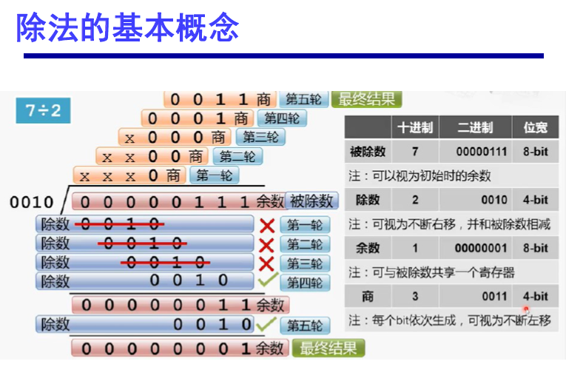

Slide 5
原码除法运算（不恢复余数法）
减法用补码加法实现，商的符号由异或实现。 被除数 ，除数
① 商的符号 商的数值
② 先用被除数减去除数
当余数为正时，商加上1，余数和商左移一位，再减去除数；
当余数为负时，商加上0，余数和商左移一位，再加上除数；
③ 当第n+1步余数为负时，则加上 得到第n+1步正确的余数（余数和被除数同号）

Slide 6
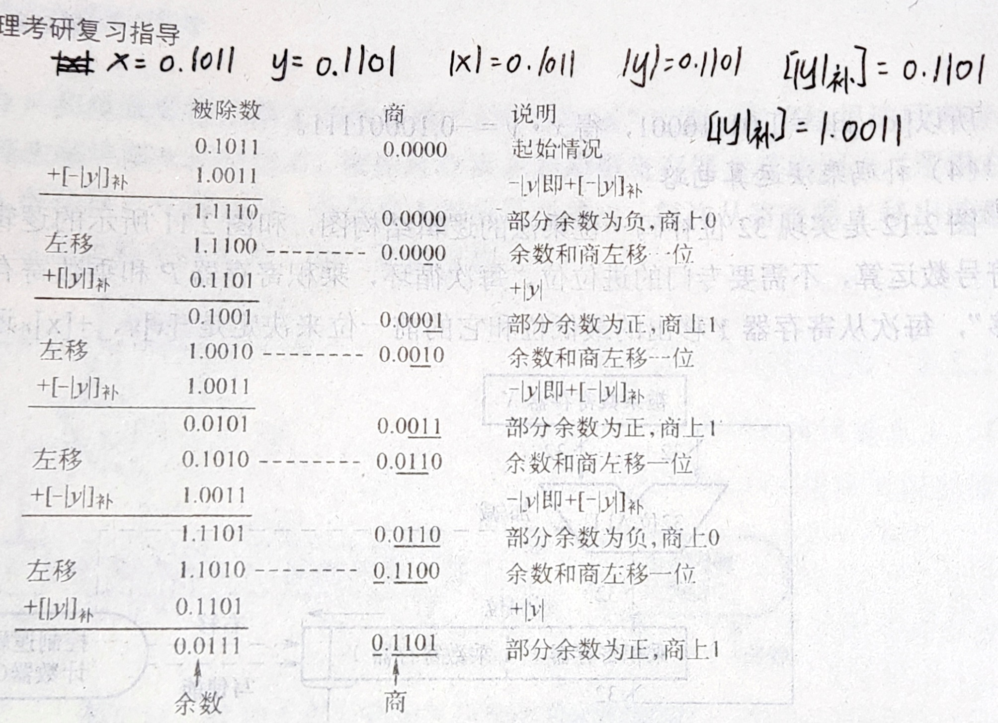

Slide 7
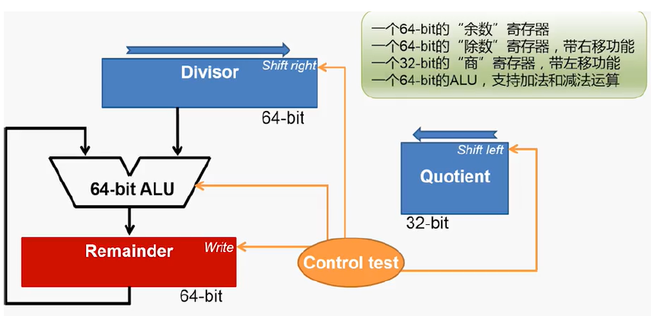
Division V1

Slide 8
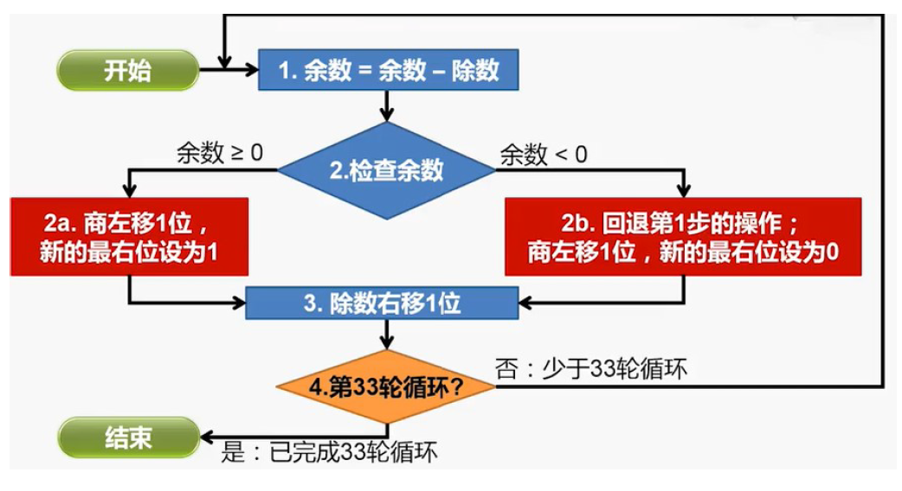

Slide 9
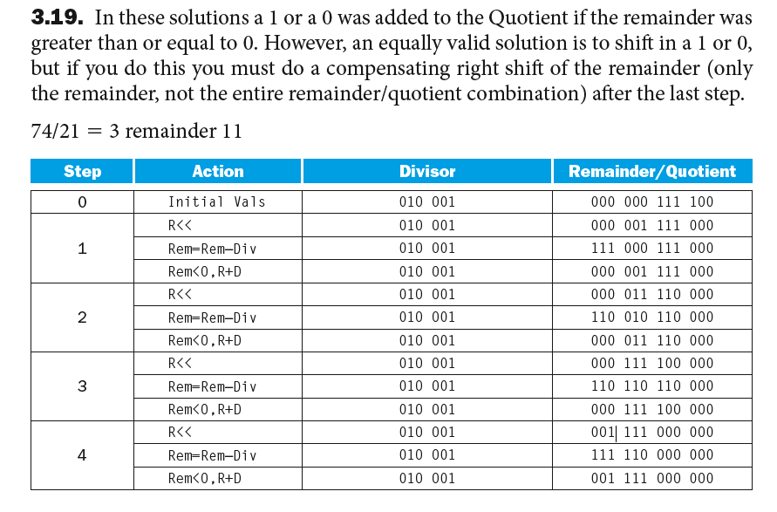

Slide 10
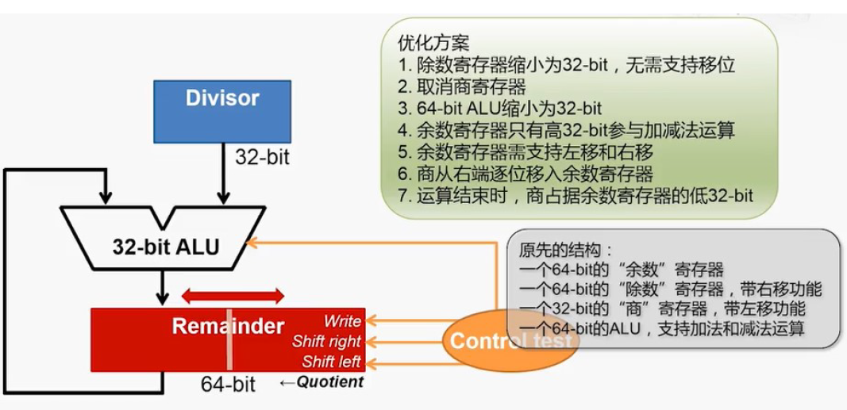
Division V3

Slide 11
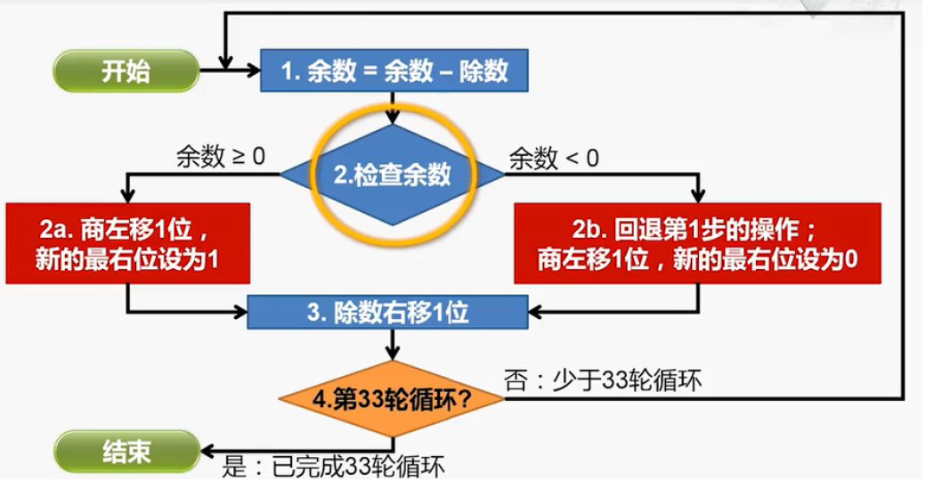

Slide 12
Example 7/2 for Division V3
iteration | step | Divisor | Remainder
0 | Initial Values | 0010 | 0000 0111
 | Shift Rem left 1 | 0010 | 0000 1110
1 | 1.Rem=Rem-Div | 0010 | 1110 1110
 | 2b: Rem<0 →+Div,sll R,R₀=0 | 0010 | 0001 1100
2 | 1.Rem=Rem-Div | 0010 | 1111 1100
 | 2b: Rem<0 →+Div,sll R,R₀=0 | 0010 | 0011 1000
3 | 1.Rem=Rem-Div | 0010 | 0001 1000
 | 2a: Rem>0 →sll R,R₀=1 | 0010 | 0011 0001
4 | 1.Rem=Rem-Div | 0010 | 0001 0001
 | 2a: Rem>0 →sll R,R₀=1 | 0010 | 0010 0011
 | Shift left half of Rem right 1

Slide 13
Signed division符号数除法
Keep the signs in mind for Dividend and Remainder
(+ 7) ÷( + 2) = + 3 Remainder = +1
7 = 3 × 2 + (+1) = 6 + 1
(- 7 ) ÷(+ 2) = - 3 Remainder = -1
-7 = -3 × 2 + (-1) = - 6 - 1
(+ 7 ) ÷( - 2) = - 3 Remainder = +1
(- 7 ) ÷( - 2) = + 3 Remainder = -1
One 64 bit register : Hi & Lo
Hi: Remainder, Lo: Quotient
Instructions: div, divu
Divide by 0 / overflow : Check by software
7 / 2 | 3 | 1
-7 / 2 | -3 | -1
7 / -2 | -3 | 1
-7 / -2 | 3 | -1
sign of Quotient = x sign⊕ y sign
sign of remainder = x sign

Slide 14
2 Floating point numbers

Slide 15
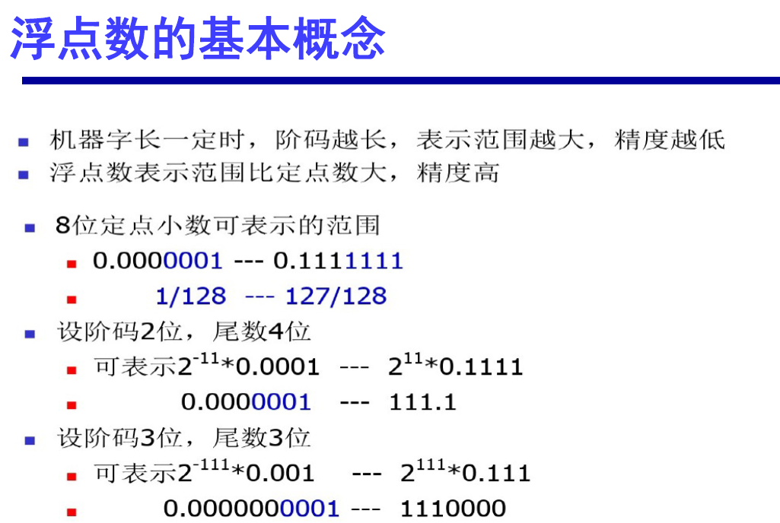

Slide 16
Floating point numbers
31 | 30 …… 23 | 22 …… 0
S | exponent | fraction
1 bit | 8 bits（1~254） | 23 bits
Single precision
31 | 30 …… 20 | 19 …… 0
S | exponent | fraction
1bit | 11 bits（1~2046） | 52 bits
Double precision
Exponent is biased(移码），float偏置127，double偏置1023
Fraction用原码（尾数）
阶码的位数反应浮点数的表示范围,尾码则显示了精度
由于规格化后小数点最高位总是1，因此这这一位隐藏。23位尾数实际上可以表示24位有效数字

Slide 17
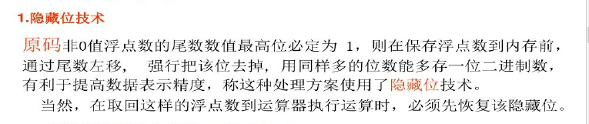
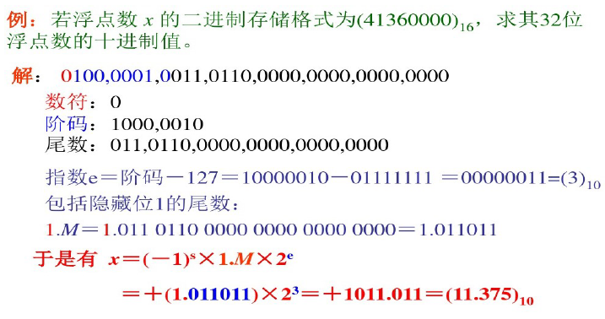

Slide 18
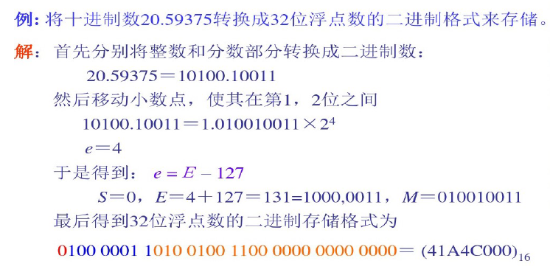

Slide 19
规格化
fraction的位数决定浮点数的有效位数，有效位数越多，精度越高。规格化，调整非规格化浮点数的尾数和阶码，使得非零的浮点数在尾数的最高位数上保证是1
IEEE 743规格化的尾数形式为±1.xxxx, 尾数相加减后的结果可能是
第一种情况需要右规:尾数右移1位，阶码加1。尾数右移，最高位1被移到小数点前1位作为隐藏位，最后一位移除时，需考虑舍入（右规只要1次）
右规一次，相当于除2；左规一次，相当于乘2
第二种情况需要左规：尾数左移1位，阶码减1.左移要多次

Slide 20
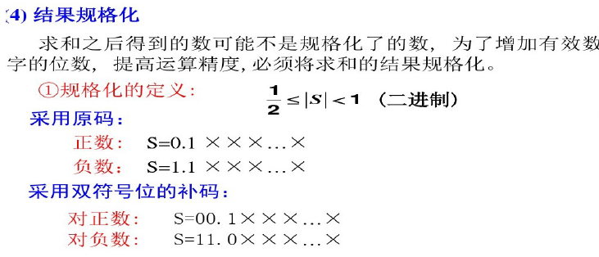
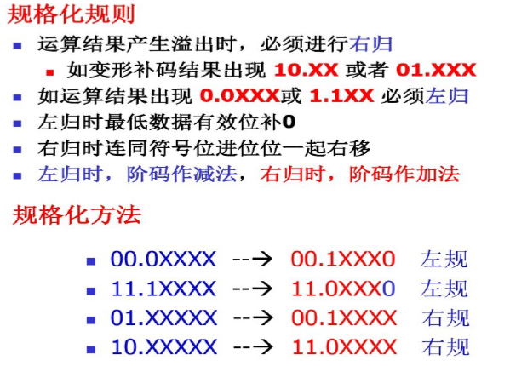

Slide 21
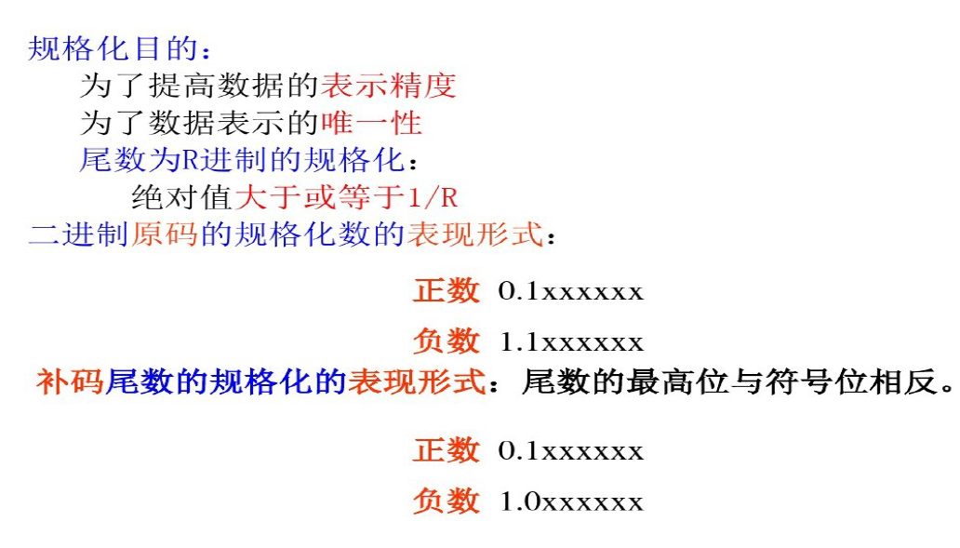
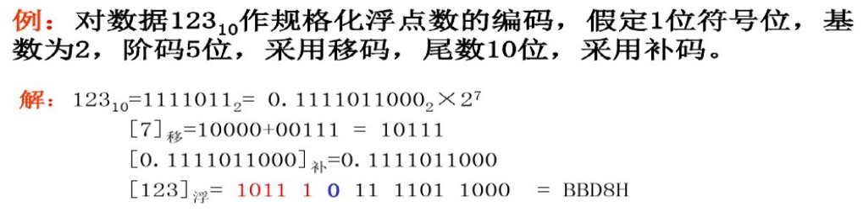

Slide 22
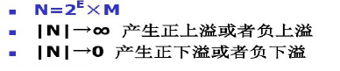
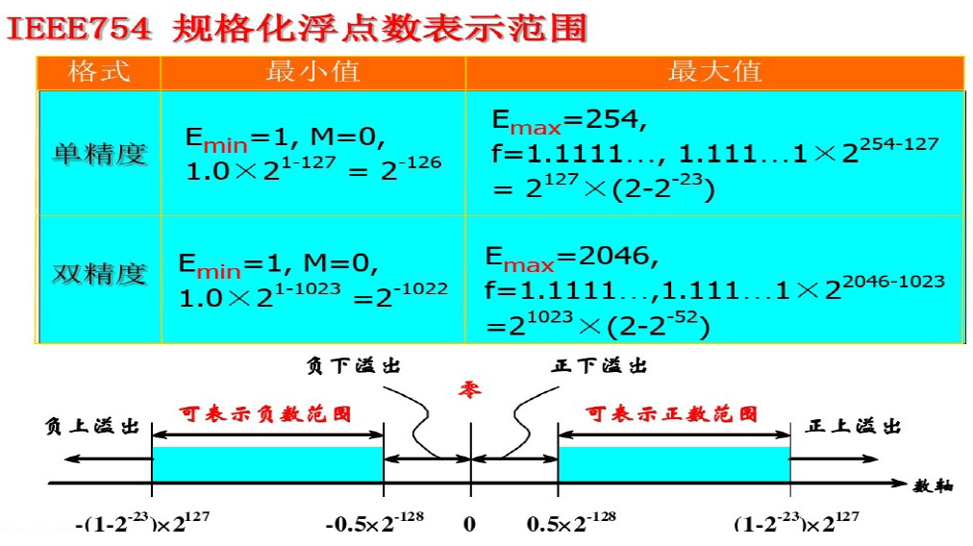
Limitations

Slide 23
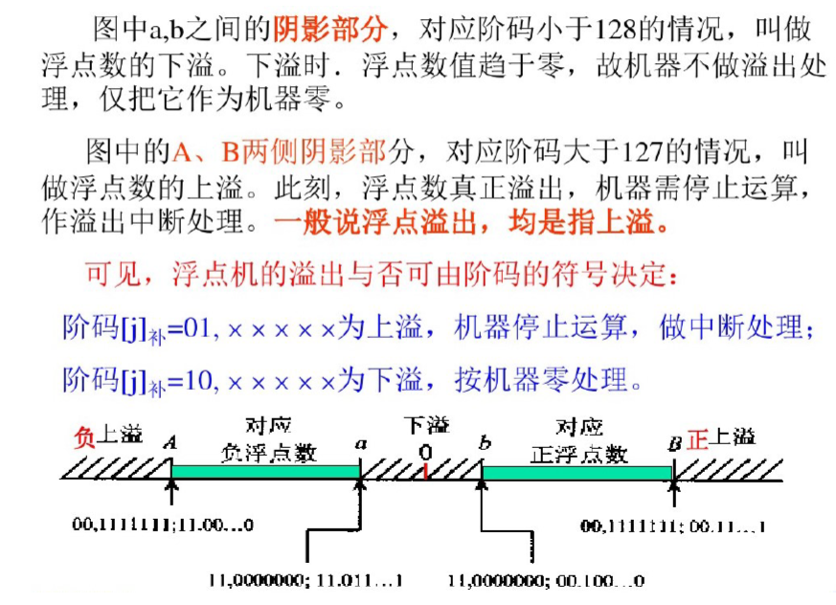
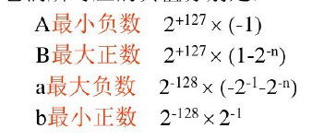

Slide 24
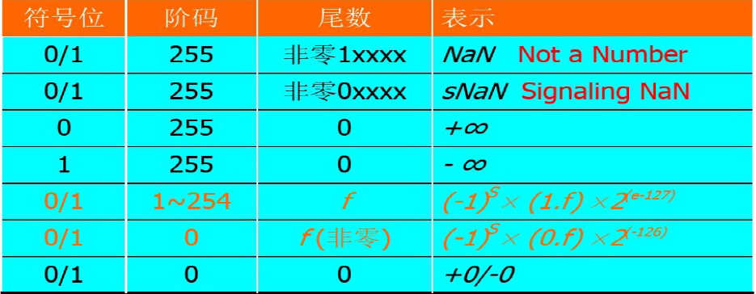
IEEE 754 standard
00... 00_{two} represents 0;
instead of interrupting on a divide by 0, software can set the result to a bit pattern representing +∞ or -∞;
NaN: Not a Number.
±∞ - represented by f=0, E=255, S=0,1 - must obey all mathematical conventions: F+∞=∞, F/∞=0
Unnormalized numbers - represented by E=0 -values smaller than smallest normalized number - lowering probability of exponent underflow

Slide 25
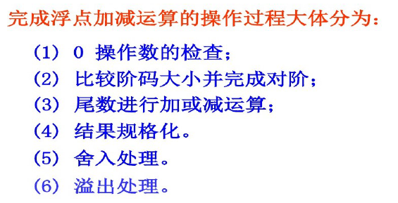
小阶向大阶看齐（右移一位阶+1，影响精度）
为保证精度，一般将低位溢出的两位保留，参与中间运算过程

Slide 26
Example: y=0.5+(-0.4375) in binary
0.5₁₀ = 1.000₂×2⁻¹
-0.4375₂=-1.110₂×2⁻²
Step1:The fraction with lesser exponent is shifted right until matches
-1.110₂×2⁻² → -0.111₂×2⁻¹
Step2: Add the significands
1.000₂×2⁻¹
+) - 0.111₂×2⁻¹
0.001₂×2⁻¹
Step3: Normalize the sum and checking for overflow or underflow
0.001₂×2⁻¹ → 0.010₂×2⁻² → 0.100₂×2⁻³ → 1.000₂×2⁻⁴
Step4: Round the sum
1.000₂×2⁻⁴ = 0.0625₁₀
注意有时候会多两位计算精度位GR

Slide 27
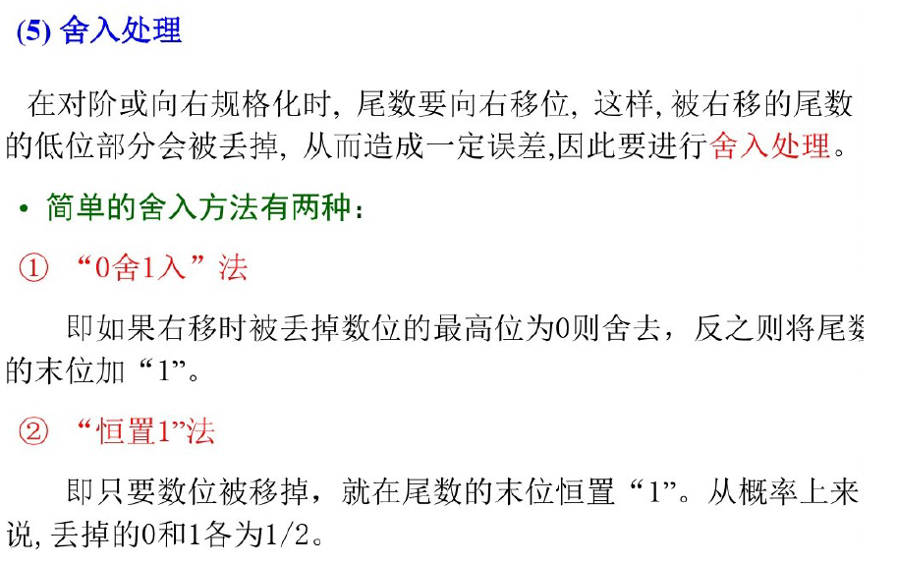

Slide 28
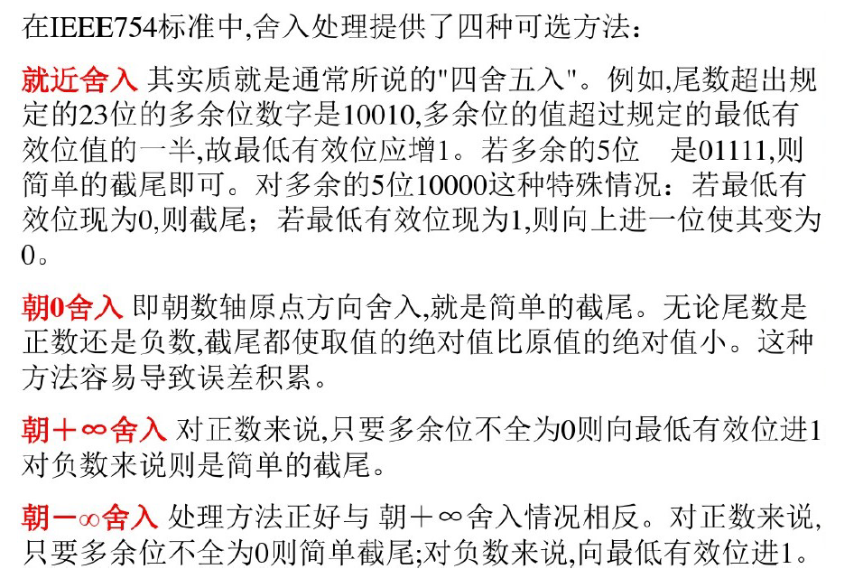
IEEE 754 round modes舍入

Slide 29
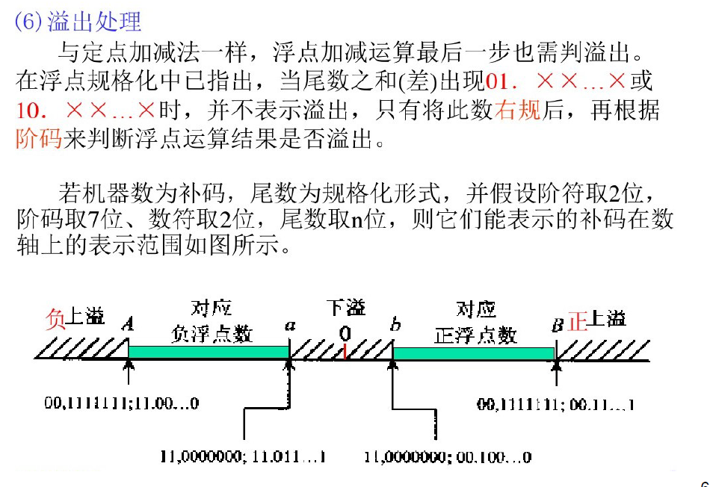

Slide 30
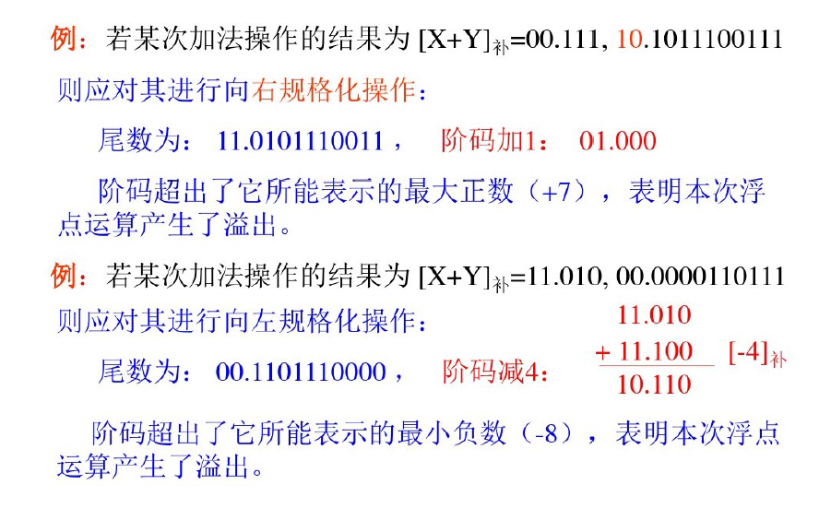

Slide 31
Multiplication 乘法
Composition of number from different parts → separate handling
(s1 • 2^{e1}) • (s2 • 2^{e2}) = (s1 • s2) • 2^{e1+ e2}
Example
1 10000010 000 0000 0000 0000 0000 0000 = -1 × 2³
0 10000011 000 0000 0000 0000 0000 0000 = 1 × 2⁴
Both significands are 1 → product = 1 →Sign=1
Add the exponents, bias = 127
10000010
+10000011
110000101
Correction: 110000101-01111111=10000110=134=127+3+4
The result: 1 10000110 000 0000 0000 0000 0000 0000 = -1 × 2⁷
Notes:
双符号位不要求
浮点数乘除法大概知道怎么回事就行了

Slide 32
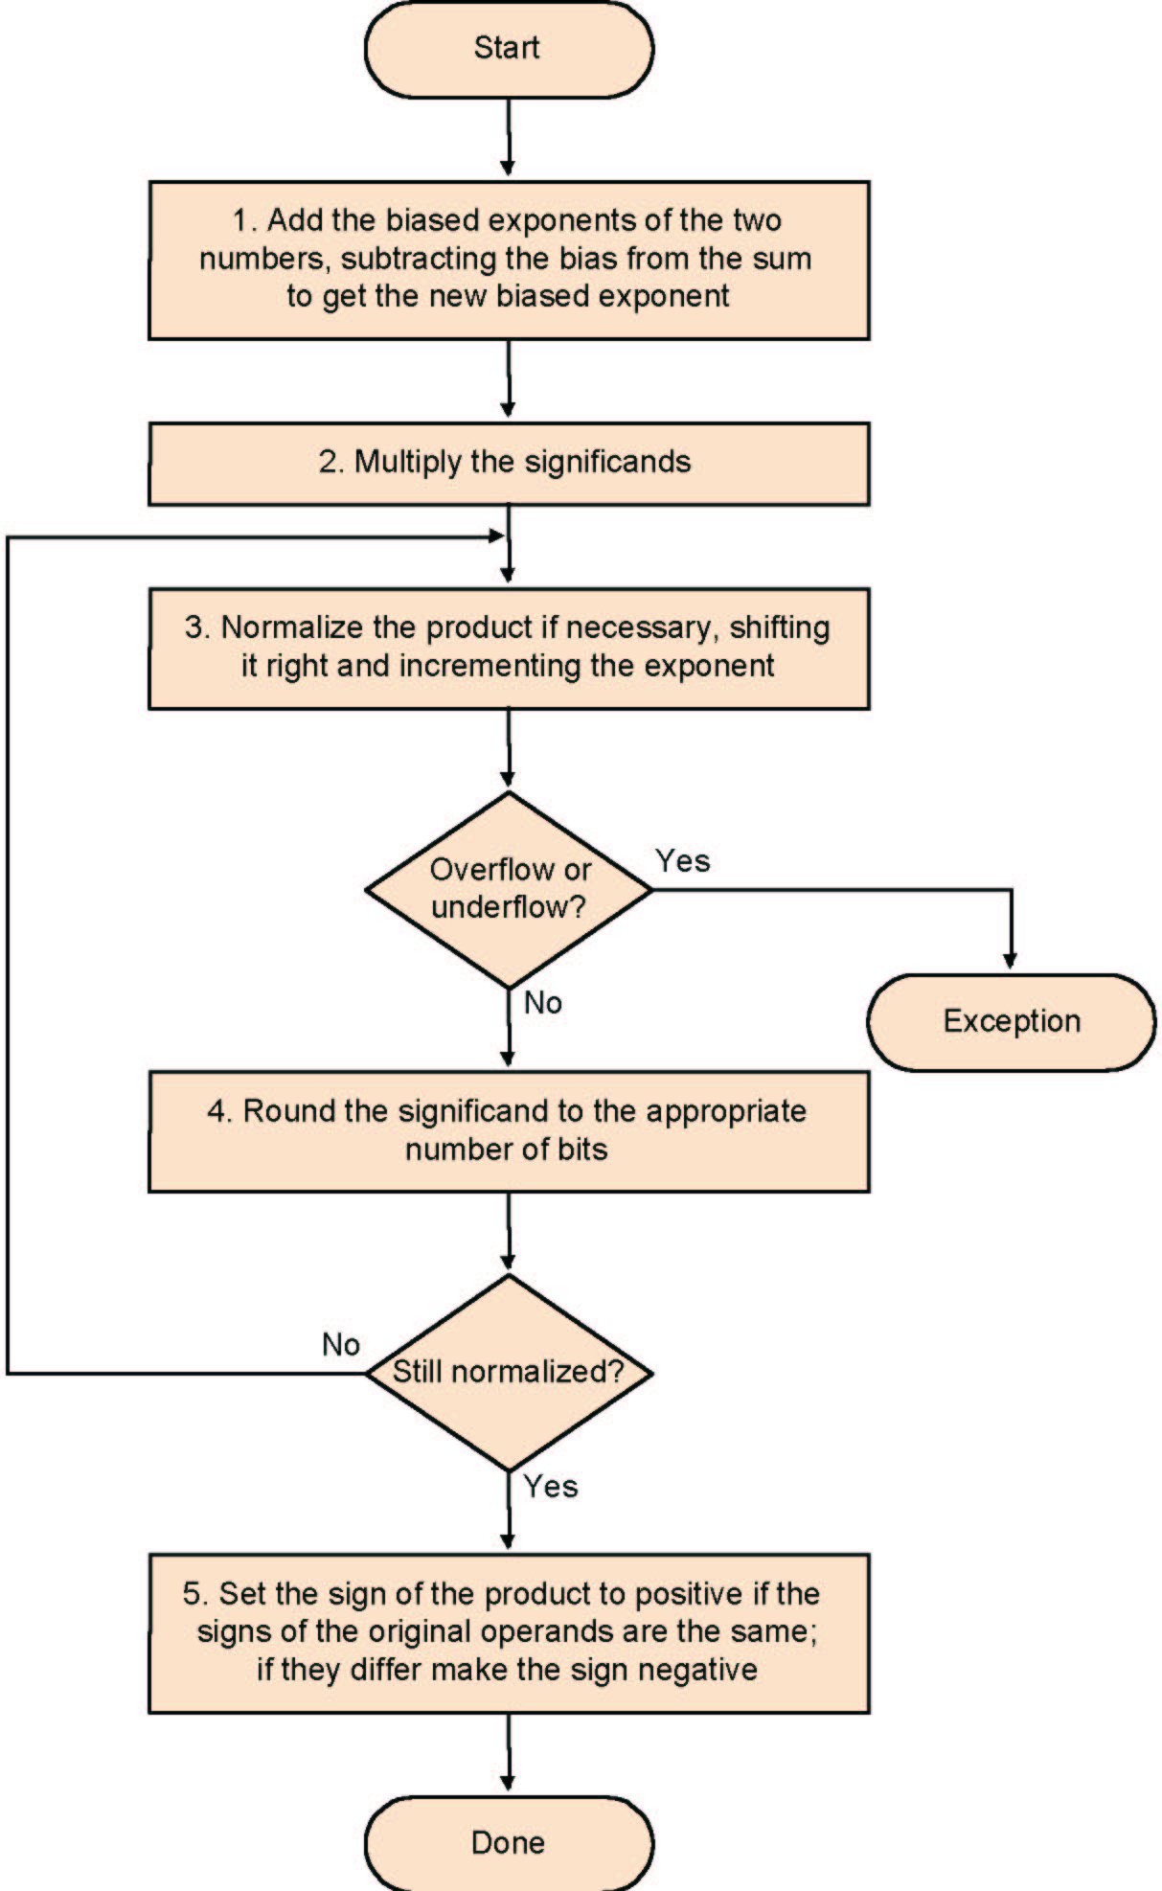
Add exponents
Multiply the significands
Normalize
Over- underflow
Rounding
Sign

Slide 33
ULP and Lsb
ULP
Unit in the Last Place or unit of least precision
相邻浮点数之间的距离
If ULP(x) is less than or equal to 1, then x + 1 > x. Otherwise, x + 1 = x.
Lsb
the value the least significant bit
determining whether the number is even or odd

Slide 34
Parallelism and Computer Arithmetic: Associativity
if x + (y+ z) = (x + y) + z ?
x = -1.5_{ten} x 10³⁸, y= 1.5_{ten} X 10³⁸, and z = 1.0
x + (y + z) = 0.0
(x+y) + z = 1.0
不满足结合律，和精度有关系

Slide 35
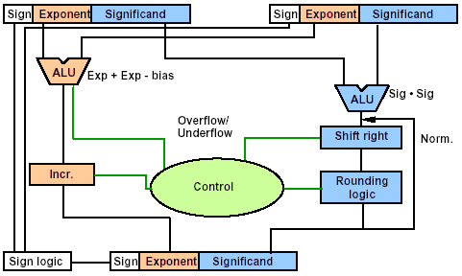
Data Flow

Slide 36
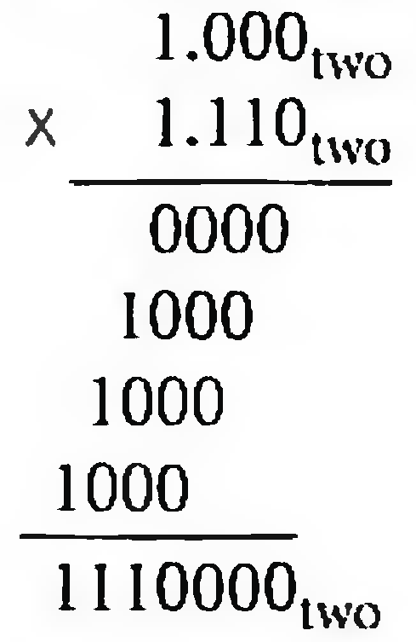
multiplying the numbers 0.5_{ten} and -0.4375_{ten} →1.000_{two}x 2⁻¹ by -1.110_{two}x 2⁻²
Step1:Adding the exponents without bias or using the biased
-1 + (-2)=-3
(-1 + 127) + (-2 + 127) - 127 = (-1 - 2) + (127 + 127-127) =-3+127 = 124
Step 2. Multiplying the significands
1.110000_{two}x2⁻³
Step 3. normalize
127 ≥ -3 ≥ -126, no overflow or underflow.
Step 4. Rounding
1.110_{two}x2⁻³
Step 5. sign
-1.110_{two}x2⁻³ =-0.21875_{ten}

Slide 37
Division-- Brief
Subtraction of exponents
Division of the significants
Normalisation
Runding
Sign

Slide 38
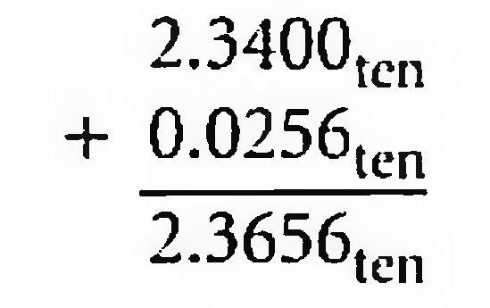
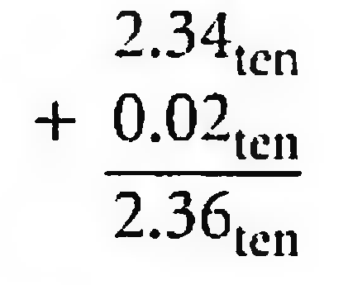
Accurate Arithmetic
IEEE 754 always keeps two extra bits on the right during intermediate additions, called guard and round
Rounding with Guard Digits 先算再四舍五入
Add 2.56_{ten} x 10⁰ to 2.34_{ten} x 10²
The guard digit holds 5 and the round digit holds 6.（加法一个guard就足够，乘法需要round）
Sum=2.37_{ten} x 10².
Rounding without Guard Digits
Sum=2.36_{ten} x 10²

Slide 39
sticky bit
A bit used in rounding in addition to guard and round that is set whenever there are nonzero bits to the right of the round bit.
allows the computer to see the difference between 0.50 ... 00_{ten} and 0.50 ... 01_{ten} when rounding.区分0.5和比0.5大一点
examples in the floating point format with guard, round and sticky bits

Slide 40
Examples for guard, round, and sticky bit
g r s
1.11000000000000000000100 0 0 0
1.11000000000000000000100 (mantissa used, exact representation)
1.11000000000000000000000 1 1 0
1.11000000000000000000001
1.11000000000000000000000 0 1 0
1.11000000000000000000000
1.11000000000000000000000 1 1 1
1.11000000000000000000001
1.11000000000000000000000 0 0 1
1.11000000000000000000000
1.11000000000000000000000 1 0 0 (the “halfway” case) 1.11000000000000000000000 （LSB=0）
1.11000000000000000000001 1 0 0 (the “halfway” case) 1.11000000000000000000010（LSB=1）
凑偶

Slide 41
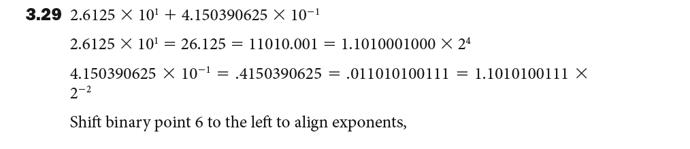
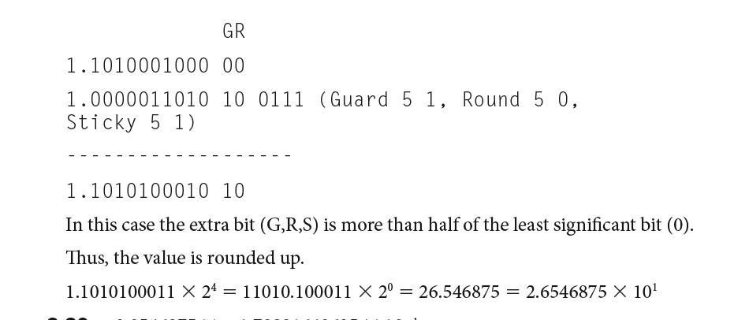
16位下的GRS

